Slide 1
AFFILIATE PROGRAM

Slide 2





Telegram:-@incomesathi
The model of attraction of investments
The investments are attracted by corporate crowdinvesting. The model approved itself and became a modern world trend. It lets involve thousands of associates from any countries, who become joint holders on initial stages of the project when the share value is minimal and in 2-3 years it can grow up 50-100 times, sometimes even 300 times.
1
The founder of the project herewith holds the general share and therewith guarantees prefer- ences promised to the early investors.
2
WETER project allocates 40% of budget to risk-free advertising as affiliate program, which guarantees the correct application of financial resources with a payment for achieved result, is used.
3
The crowdinvesting and affiliate program model will be valid till the moment of sale of the fist license for technol- ogy application.

Slide 3
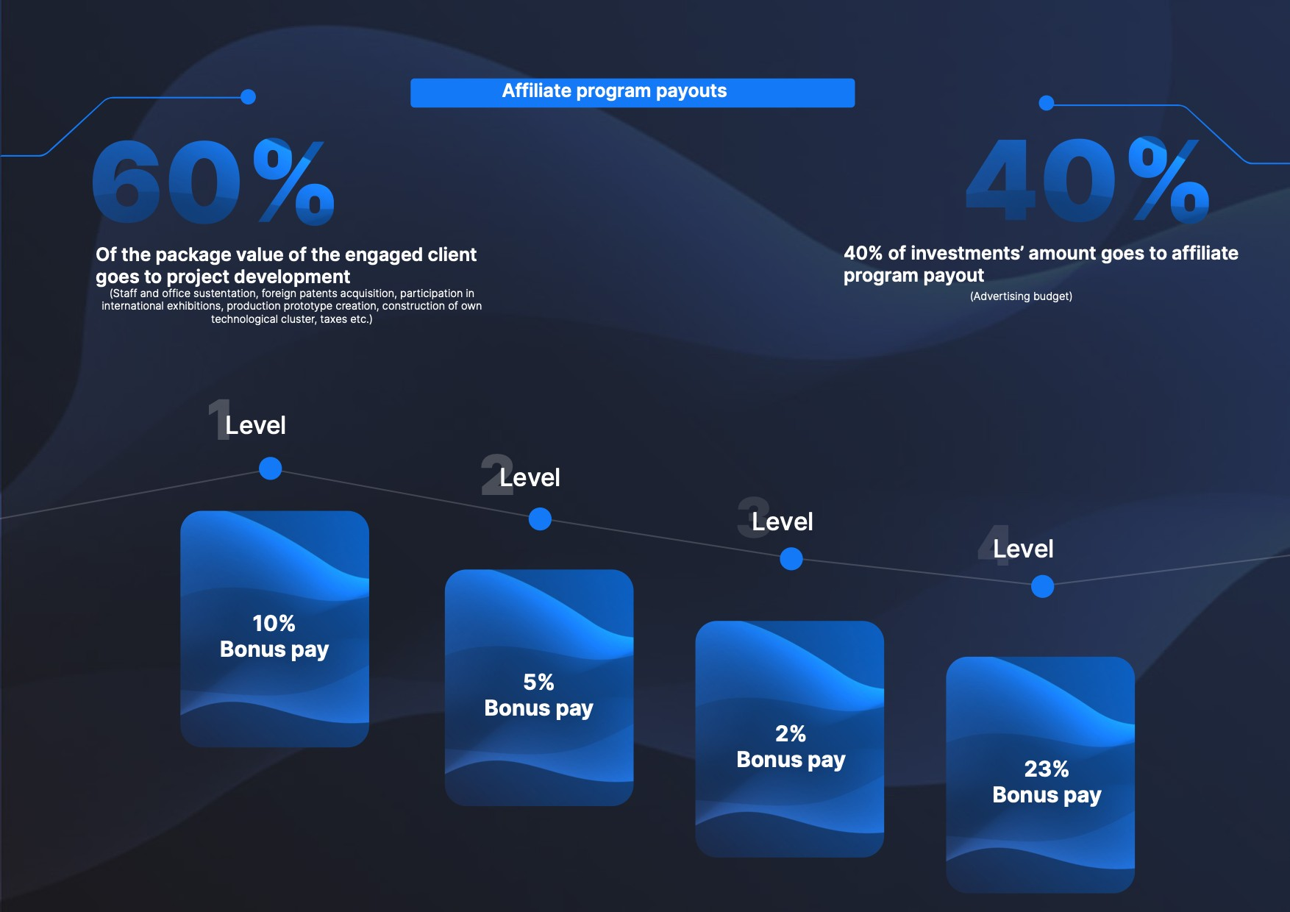
Telegram:-@incomesathi

Slide 4
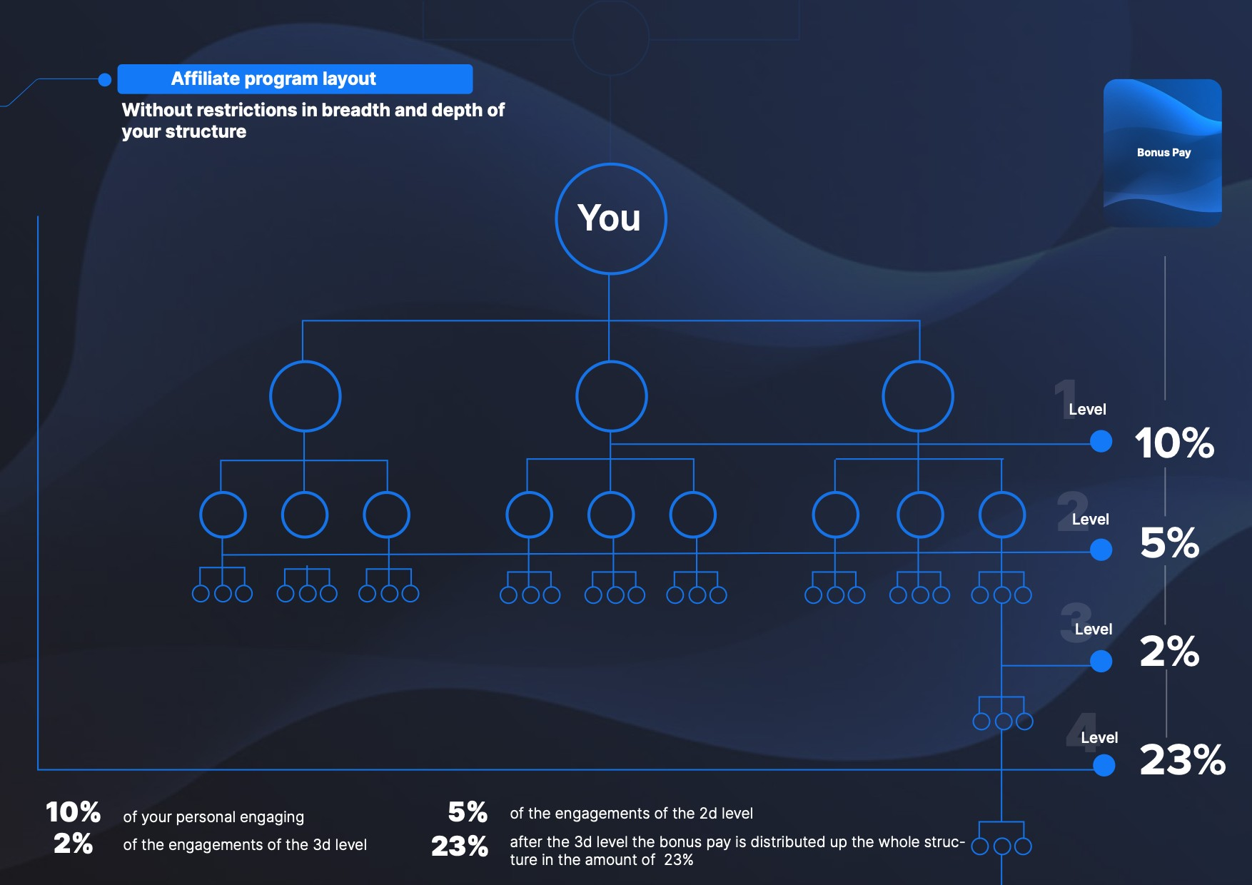
Telegram:-@incomesathi

