Slide 1
www.incomesathi.com

Slide 2
www.incomesathi.com
WELCOME
All Business Partners
Ai.Marketing & INB.Network
MarketBot Presentation
Telegram:-@incomesathi

Slide 3
www.incomesathi.com
Telegram:-@incomesathi

Slide 4
www.incomesathi.com
MARKETBOT
What Is……. ……?
MarketBot is a
Global Trends Analysis Technology
MarketBot monitors trends in social media and search queries and predicts the future demand analyzing the keywords popularity dynamics.
मार्केटबॉट सोशल मीडिया और खोज प्रश्नों में रुझानों की निगरानी करता है और कीवर्ड लोकप्रियता गतिशीलता का विश्लेषण करते हुए भविष्य की मांग की भविष्यवाणी करता है।
Telegram:-@incomesathi

Slide 5
www.incomesathi.com
Artificial Intelligence
Artificial Intelligence is playing a very important contribution in today’s digital age to attract new targeted customers ?
Telegram:-@incomesathi

Slide 6
Telegram:-@incomesathi
MarketBot
Earn up to 30% cashback!
Without complications
Activate you robot now
and get up to 30% of your Adds Budget a month!
www.incomesathi.com

Slide 7
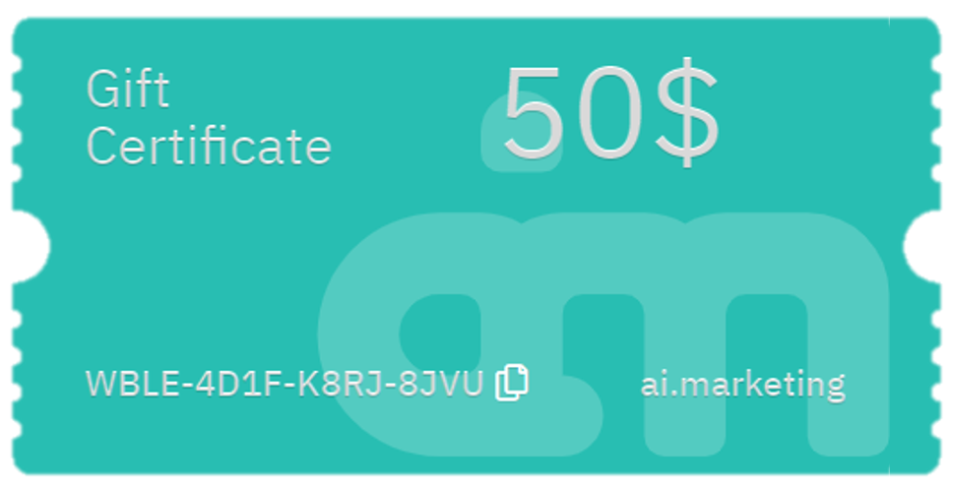
www.incomesathi.com
HOW DOES IT WORK ?
You are setting the adds Budget
MarketBot Picks up trendy products, finds them at the cheapest price with the maximum cashback offered and buys high-quality advertising.
You get up to 15% Cashback on each and every purchase
Telegram:-@incomesathi

Slide 8
www.incomesathi.com
With the increased number of marketplaces the problem became exact opposite. There are a lot trading aggregators, such
as Ebay, Amazon, Ali-Baba and many others out there and not enough customers at satisfy them all.

Slide 9
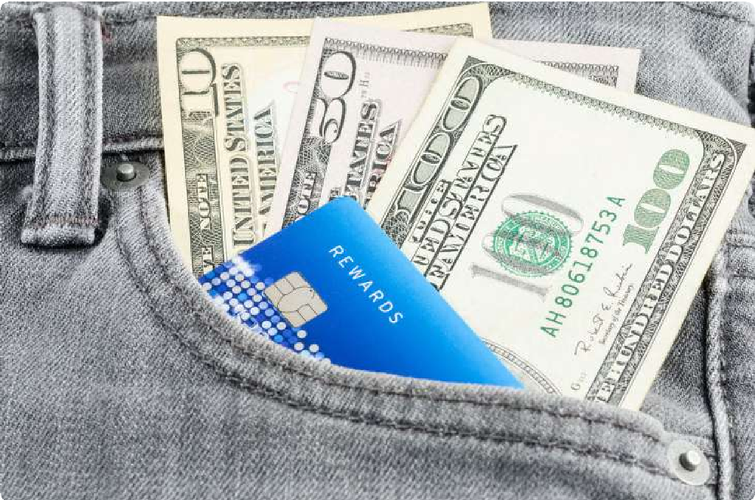
www.incomesathi.com
The war for customers has began and cashback is one of the
strategies in that battle.
Aggregators pay commission for attracting customers.
The people call it it cashback.
Depending on the website the cashback can vary from 1.5%
to 15% for goods and from 15 to 60% for services.
Telegram:-@incomesathi

Slide 10
We invite trading platforms, online stores, websites offering products and services to join us.
www.incomesathi.com

Slide 11
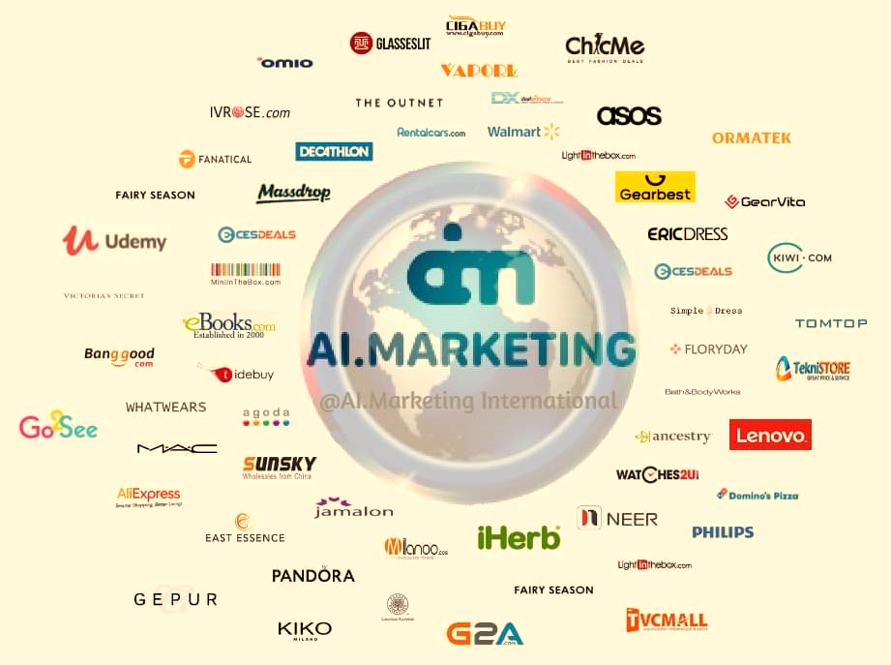
Telegram:-@incomesathi
MarketBot Technology
Over 20,000 online cashback stores
We offer the best cashback the is on the market.
Cashback Provider
www.incomesathi.com

Slide 12
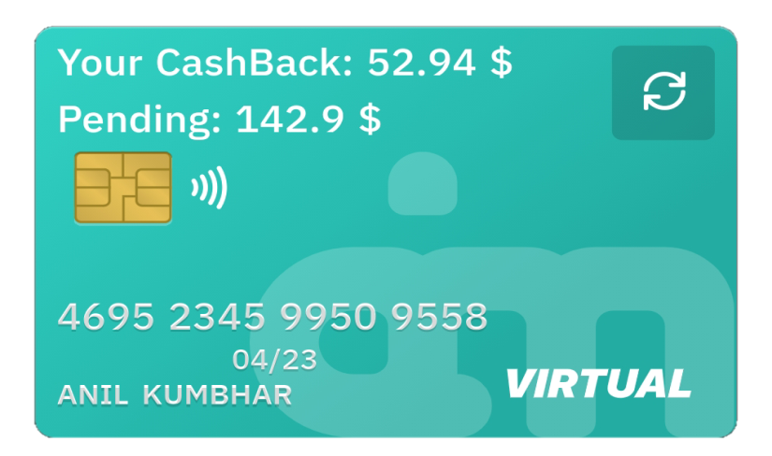
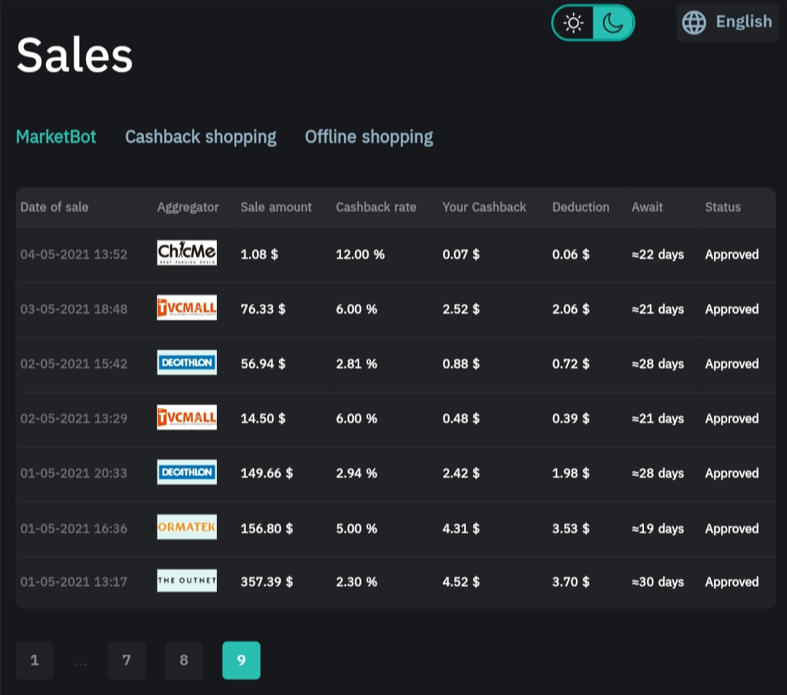
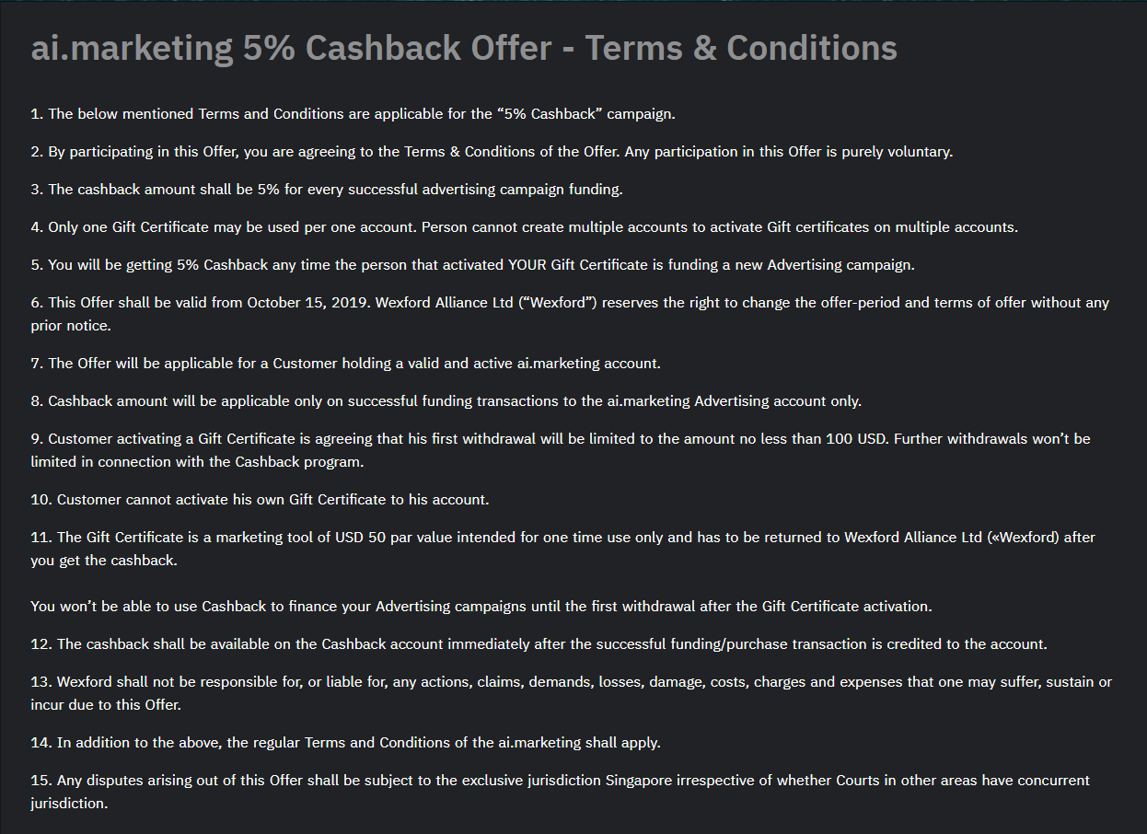
All
Business
Models
www.incomesathi.com

Slide 13
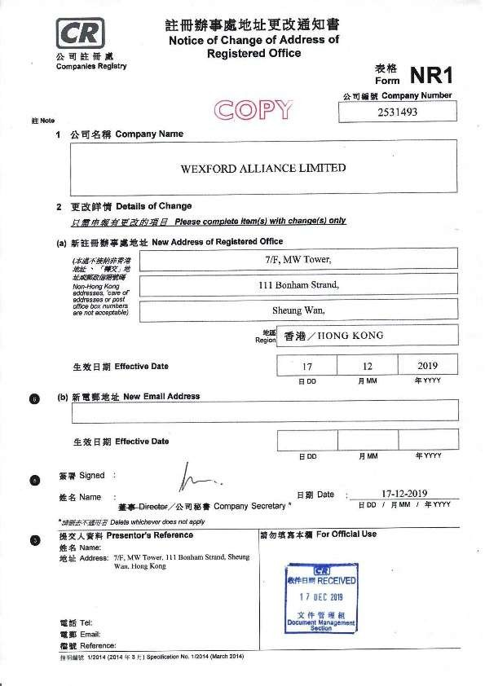
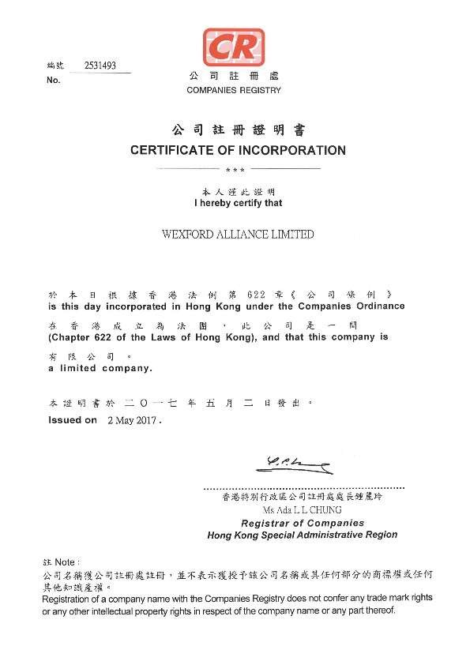
www.incomesathi.com
Legal Information
Establisher in 2017
Company activity
Scientific Studies
Artificial Intelligence
Internet Marketing
Telegram:-@incomesathi

Slide 14
Telegram:-@incomesathi
Required Information
Full Name
Valid Email ID
Sign in / Enter using social network account
Cashback Provider
Network Marketing / Referral Program
Work24/7
Daily Cashback payments
Signal Level Referral Program
( Provide gift Code & get 5% cashback )
MARKETBOT
No Network Marketing
Bonus (210,00,00,000/-)
Gap Benefit Up to 10%
www.incomesathi.com

Slide 15
Telegram:-@incomesathi
Benefits Of INB Network
Total Business Turnover Gap Benefit (PRTN)
Indirect Business Turnover Bonus (NBO’s)
www.incomesathi.com

Slide 16
Telegram:-@incomesathi
Total
Business Turnover
Gap Benefit
PRTN
GAP BENEFIT ( PRTN ) UP TO 10%
Level
Designation
0
0
1
2
3
4
5
6
7
8
9
10
11
12
13
14
15
16
17
18
19
Partner
-----------
5%
Agent
$ 50,100,500
5%
What are PRTN assets?
$ 4096
6%
1%
Leading Agent
VIP Agent
$ 8192
7%
4%
PRTN assets is the account that the referral income is credited to. The par value of PTRN is 1:1 USD. Account balance is available for withdrawal in accordance with the current terms.
Manager
$ 32768
9%
Leading Manager
$ 65536
10.5%
$ 131072
U
VIP Manager
12%
Director
$ 262144
13%
6%
Leading Director
$ 524288
14%
10%
VIP Director
$ 1048576
15%
Ruby Director
$ 4194304
15%
A
B
C
Sapphire Director
$ 16777216
15%
Diamond Director
$ 67108884
15%
Gold Director
$ 134217728
15%
Platinum Director
$ 268435456
15%
Ambassador
$ 536870912
15%
Ruby Ambassador
$ 1610612736
15%
Sapphire Ambassador
$ 4831838208
15%
Diamond Ambassador
$ 14495514624
15%
Golden Ambassador
$ 43486543872
15%
Platinum Ambassador
$ 130459631616
15%
www.incomesathi.com

Slide 17
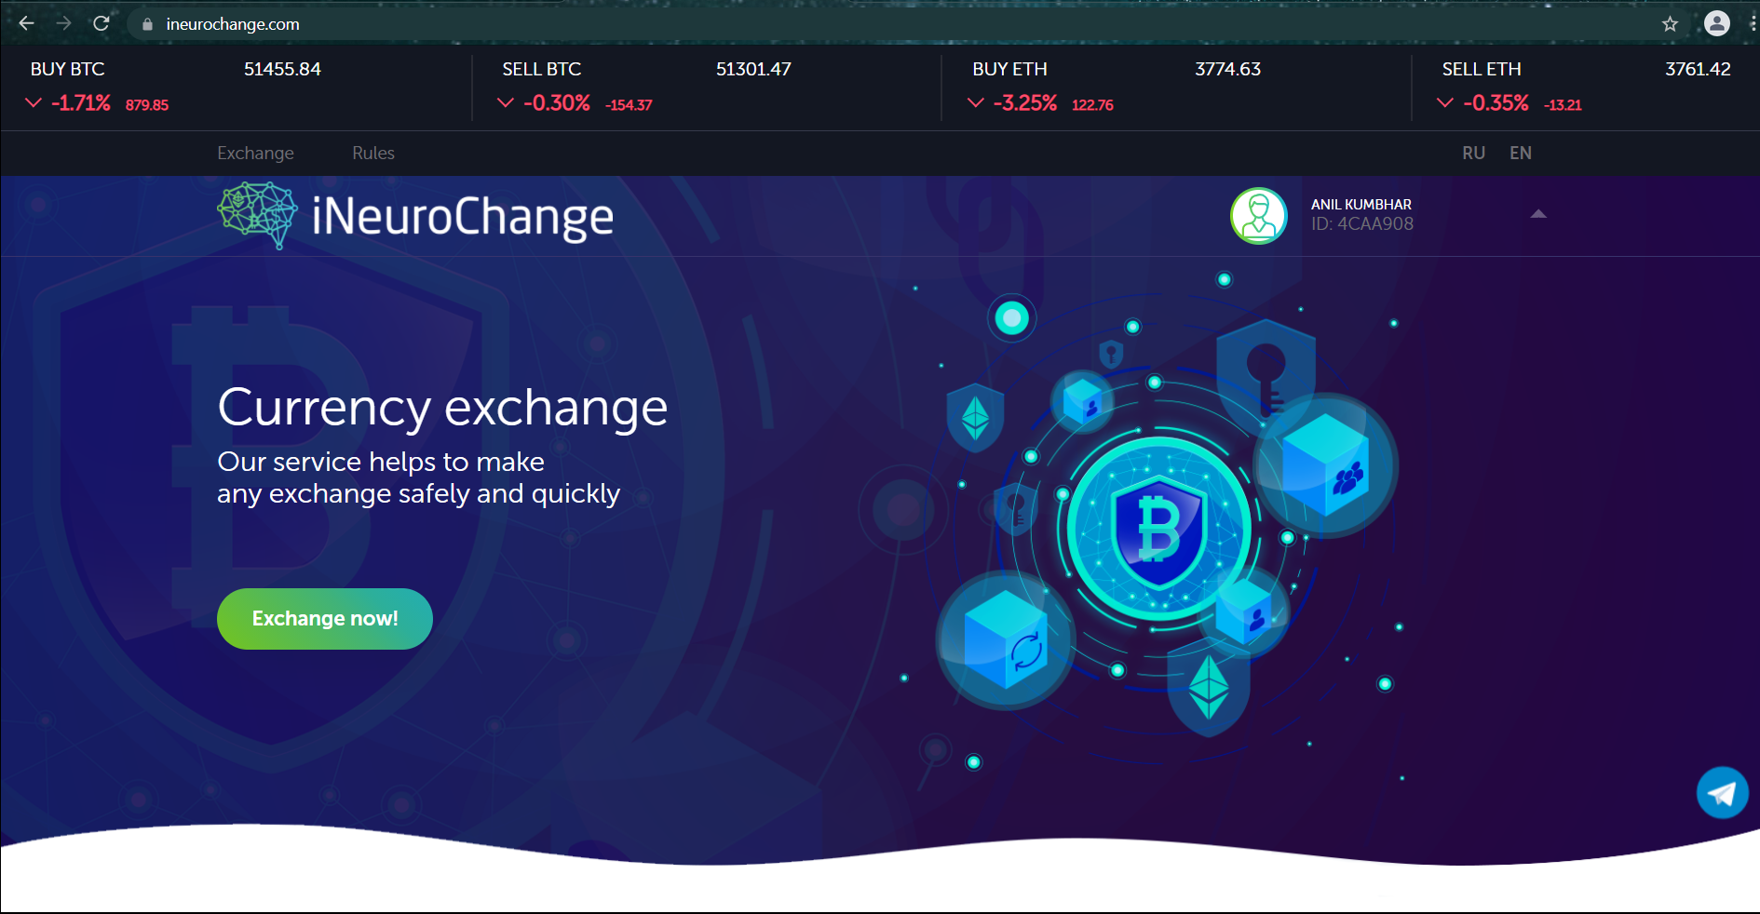
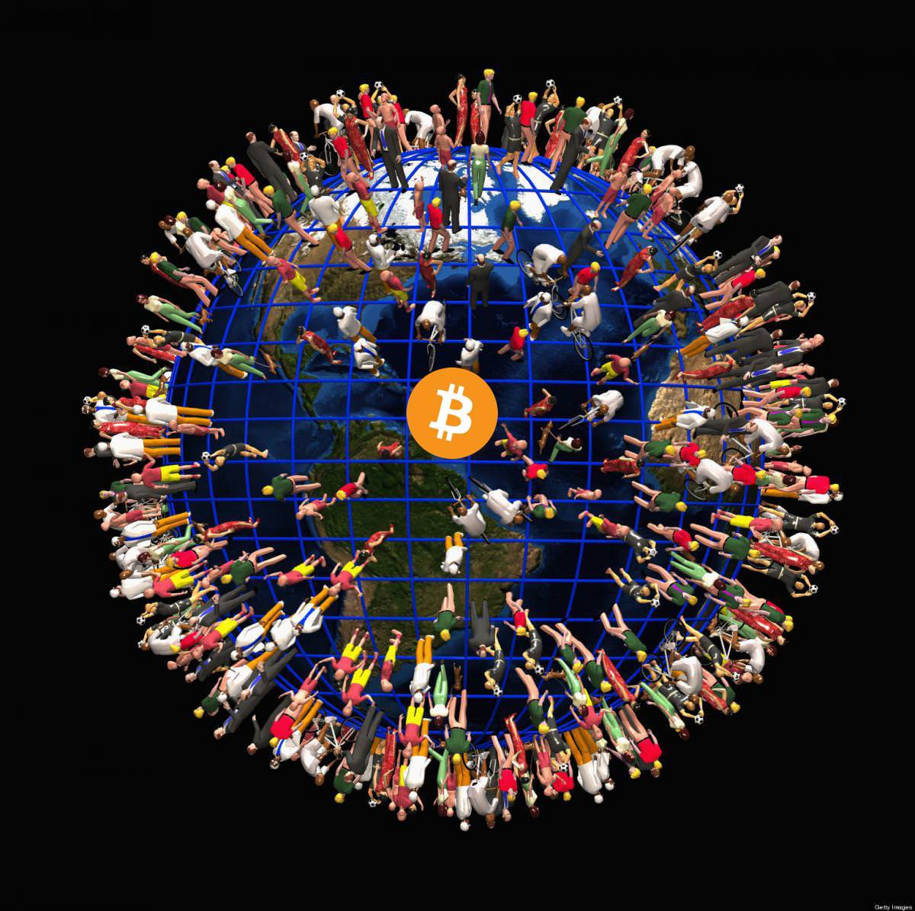
NBO’s Achievements
What are NBO assets?
BONUS Nearby 210,00,00,000/-
NBO are ERC20 standard tokens that are accepted as the internal currency of INfoBusiness.Network, NBO is traded on the P2P exchange at ineurochange.com. The par value of NBO is 1:1 USD. Actual value is determined by it’s exchange rate at ineurochange.com.
U
Level
Designation
Total
Business Turnover
Bonus NBO’s
0
0
1
2
3
4
5
6
7
8
9
10
11
12
13
14
15
16
17
18
19
Partner
-----------
-----------
Agent
$ 50,100,500
-----------
Leading Agent
$ 4096
100
VIP Agent
$ 8192
500
Direct Business
A
B
C
Manager
$ 32768
1500
Leading Manager
$ 65536
2500
VIP Manager
$ 131072
5000
Director
$ 262144
10000
Indirect Business
Leading Director
$ 524288
20000
VIP Director
$ 1048576
50000
Ruby Director
$ 4194304
150000
Sapphire Director
$ 16777216
650000
$ 4096
Diamond Director
$ 67108884
1000000
Gold Director
$ 134217728
1500000
Platinum Director
$ 268435456
2000000
Ambassador
$ 536870912
2500000
Ruby Ambassador
$ 1610612736
3000000
Sapphire Ambassador
$ 4831838208
3500000
Diamond Ambassador
$ 14495514624
4000000
How to do..?
Strong Group
Sum of Weak Grouping
Golden Ambassador
$ 43486543872
4500000
Telegram:-@incomesathi
www.incomesathi.com
Platinum Ambassador
$ 130459631616
5000000

Slide 18
www.incomesathi.com

