Slide 1

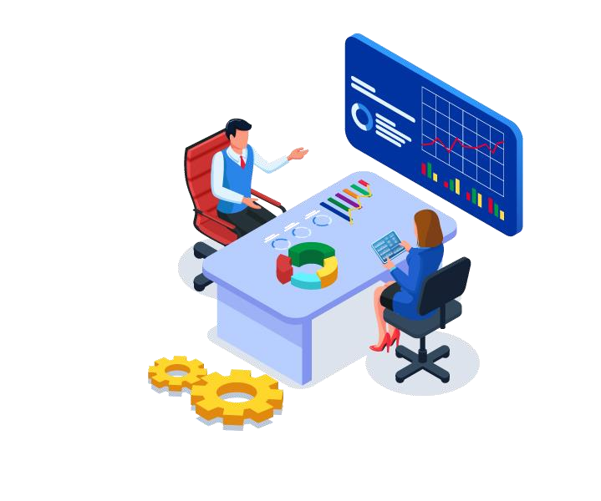
Welcome to you

Slide 2


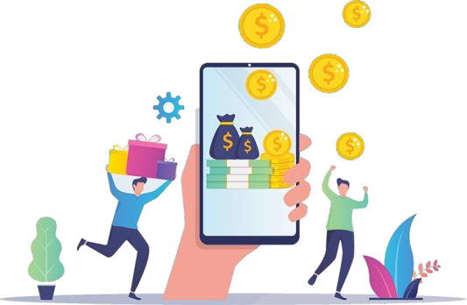
WHAT IS D-APP YEEP?
www.incomesathi.com
Introducing DAPP “YEEP” (Your everyday earning plan) which is 100% decentralized and community-based & aims to create WYZTH community with acceptance & utility & to make additional profits from the system, it is a P2P support model which insures fairness, transparency and justice for all.
NEW COMMUNITY
WYZTH
CRYPTO EARNING
USPs OF D-APP YEEP
ITO (Initial token offering) Max supply 5 crore tokens

Slide 3
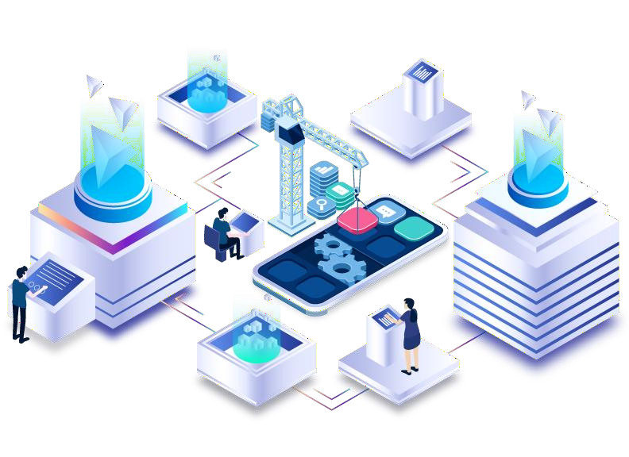
WHAT IS DECENTRALIZATION?
Decentralized marketing is created with an automated contract that offers you maximum security and sustainability. A smart contract is an automatic execution algorithm. Smart contracts, like cryptocurrencies, are decentralized. They work strictly according to the underlying program, without the possibility of subsequently changing the defined execution. The code that contains all the logic of the contract expiration is on the blockchain and all calculations are provided by millions of computers around the world. This ensures that there is no risk of hacking into the smart contract and stopping the project.
*The blockchain is an immutable record of transactions and information, which is cryptographically
protected from any subsequent manipulation using thousands of independent computers worldwide
Telegram:-@incomesathi

Slide 4
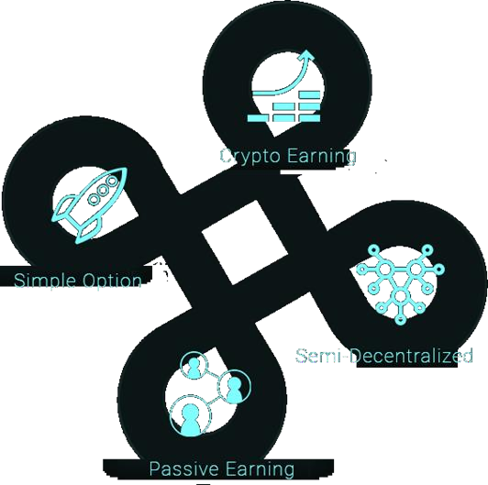
ADVANTAGES / FEATURES OF D-APP YEEP?
Investment and reward will be in wyzth token
Minimum Investment will be $100 and
multiples of $100.
Daily ROI of 1% for 300 days
10% from direct referral
Level income on ROI income of referrals - Level 1 to 20; payout 10%, 9%......1%, 1%, 2%, .... 10%
Staking Income on WYZTH starting from in option 3rd-12th Months with 0.10% -0.25% daily
Telegram:-@incomesathi

Slide 5

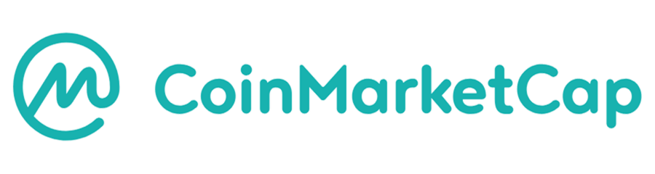
WHAT IS TRON?
Tron is a blockchain-based decentralized operating system based on cryptocurrency native to this system, known as TRX.
Where can you buy and sell?
Visit www.coinmarketcap.com and identify Crypto Exchanges operating in your countries. Thereafter, you can buy or sell crypto using your wallet.
Telegram:-@incomesathi

Slide 6
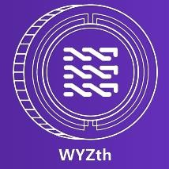

WHAT IS D-APP YEEP?
Telegram:-@incomesathi
WYZth is the transactional / Utility token that serves as units of accounts in exchange for good and services. WYZth often functions like traditional currencies with additional benefits. It is integrated into an existing protocol on the blockchain and is use to access the services on the same protocol.
The wide range of application of wyzth is as follow :

Slide 7

BUY & SWAP WYZth
Telegram:-@incomesathi
Go to www.d-app.network and exchange your TRON to WYZTH or directly you can join from TRON ( Make sure you have a balance in equals to 100 USD ) & either go to JUSTSWAP to swap your crypto (TRON) with WYZTH and same then Withdraw your WYZTH from JUSTSWAP to your Tron wallet.
You may also exchange your fiat to WYZTH via; your upline then Withdraw your WYZTH from JUSTSWAP to your Tron wallet.
x
Note : LTP (Last swap/Traded price) on justswap on 13th feb is Rs 4.37 on 21:00 pm GMT

Slide 8
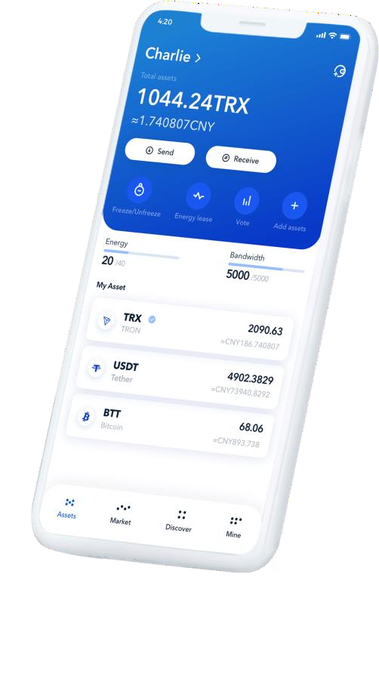
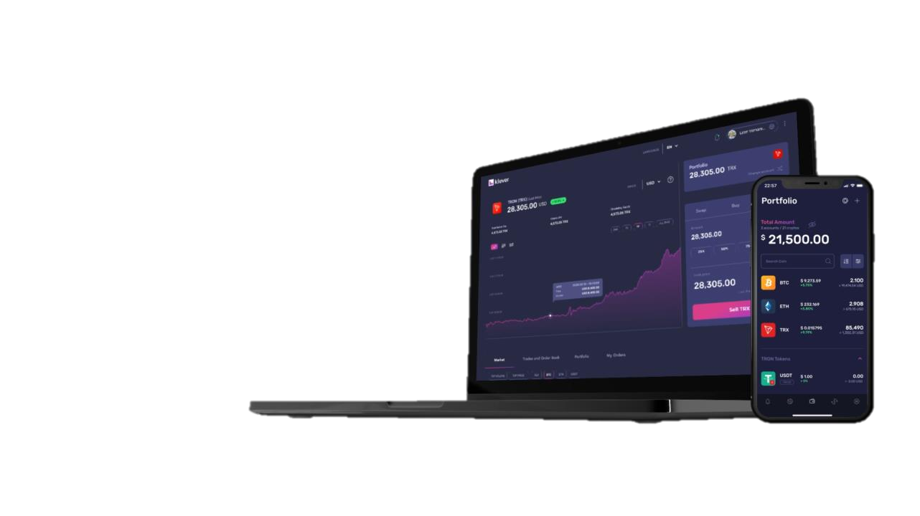


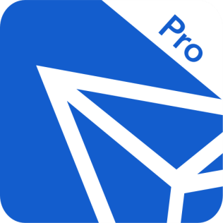


SECURE WALLETS FOR D-APP
Telegram:-@incomesathi
TRON LINK PRO

Slide 9
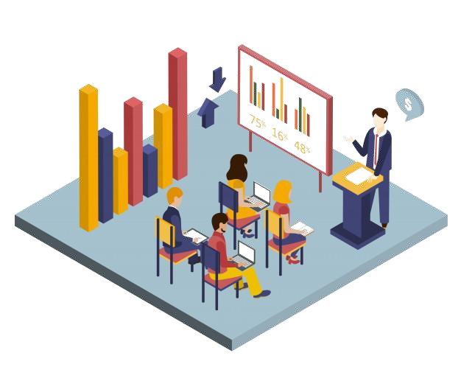
HOW D-APP YEEP WORKS?
Telegram:-@incomesathi
The DAPP “ YEEP” Smart Contract is designed to provide everyone with an independent, financial foundation based on Blockchain and Smart Contract technology.
By DEPOSITING WYZTH from tron (in equals to 100 USD or in its multiple) into the fund (contract address) you activate the program and will RECEIVE 300% WYZTH return(= 1% of 100 USD for 300 days in an year) , distributed accordingly to the Contract algorithm.
300% is inclusive of daily ROI and level income on ROI and direct referral

Slide 10

JOINING PACKAGE
Joint with 100$ & Multiple of IT
100$
Telegram:-@incomesathi

Slide 11
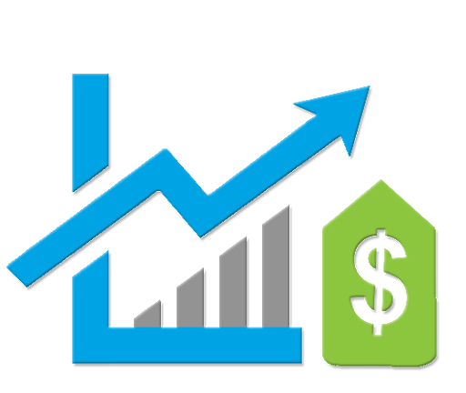
ROI INCOME
1% of Joining Amount for 300 Days in An Year
Telegram:-@incomesathi

Slide 12

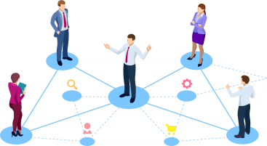
REFERRAL INCOME
10% REFERRAL INCOME
UNLIMITED DIRECT UNLIMITED INCOME

Slide 13

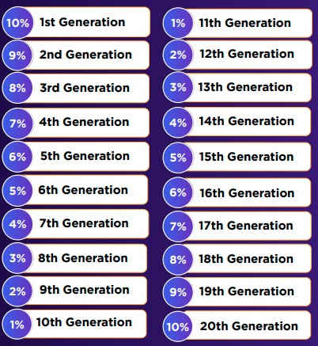
LEVEL INCOME
Note: For getting 20th generation income you have to
refer minimum 10 Directs.
Level income slab will be opened based on number of
direct referrals.
With joining or no direct referral’s 3 level income will be
opened
With 3 direct referrals; 6 level downline income will be
opened
With 5 direct referrals; 10 level downline income will
be opened
With 7 direct referrals; 15 level downline income will
be opened
With 10 direct referrals; all 20 level downline income
will be opened

Slide 14

NEFT (NET EARNING FROM TEAM) INCOME
Eligibility after 100 days
Telegram:-@incomesathi
Team earning |  |  | % AGE NEFT
 | Between $1000 to $5000 |  | 1%
 | Between $5001 to $10000 |  | 2%
 | Between $10001 to $25000 |  | 3%
 | Between $25001 to $50000 |  | 4%
 | Between $50001 to $100000 |  | 5%
 | $100001 |  | 10%

Slide 15
PAYOUT STAKING INCOME
Telegram:-@incomesathi
NO. OF DAYS | % AGE OF STAKING
90 DAYS | 0.1% DAILY
180 DAYS | 0.15% DAILY
270 DAYS | 0.2% DAILY
360 DAYS | 0.25% DAILY

Slide 16

D-APP YEEP INSURANCE
Telegram:-@incomesathi
Insurance will be used on the condition that the main YEEP contract has no fund for user withdrawals then user’s who haven’t even received their investment return through this feature I.e , Ex- Assume a user has deposited 100$ and has received payouts of only 50$, this user can make use of the insurance contract and withdraw 1% of his investment daily from insurance contract till he reaches $100.

Slide 17
RETURNS ON INVESTMENT (ROI)
Telegram:-@incomesathi
300% ROI is returned in 5 ways
(1 passive and 4 Marketing & Staking )
when 300% is accumulated through any of the 5 ways, a new deposit (REJOINING) must be made equal or greater to continue receiving from the fund.
1% Daily return on your Deposit (maximum 300 days), 100% Passive.
10%Direct Referral Commission for Sharing and Growing the WYZTH Community.
Daily ROI Downline Commission based on Partners Daily ROI , 3 level activated for each direct partner, maximum 20 levels, see below
Daily NEFT Income, Net Earning From Team from 1% to 10%
Daily Staking Income on WYZTH starting from in option 3rd-12th Months with 0.10% -0.25% daily.

Slide 18

D-APP YEEP IMPORTANT NOTES
Telegram:-@incomesathi
*DAPP “YEEP” is a community-based project, 100% decentralized, P2P transactions through Smart Contract.
*Each Deposit Cycle is 300% in WYZTH.
*When 300% is received, a new deposit (TOP UP) must be made either equals to or greater than to
continue earning / receiving from any of the 5 ways.
*No referrals required in order to receive 1% pays out daily
to all members, 100% passive.
*Increase the speed of your returns by growing the WYZTH community through marketing / sharing of
DAPP “YEEP

Slide 19

CONTACT US
VISIT OUR WEBSITE :
www.incomesathi.com

Slide 20
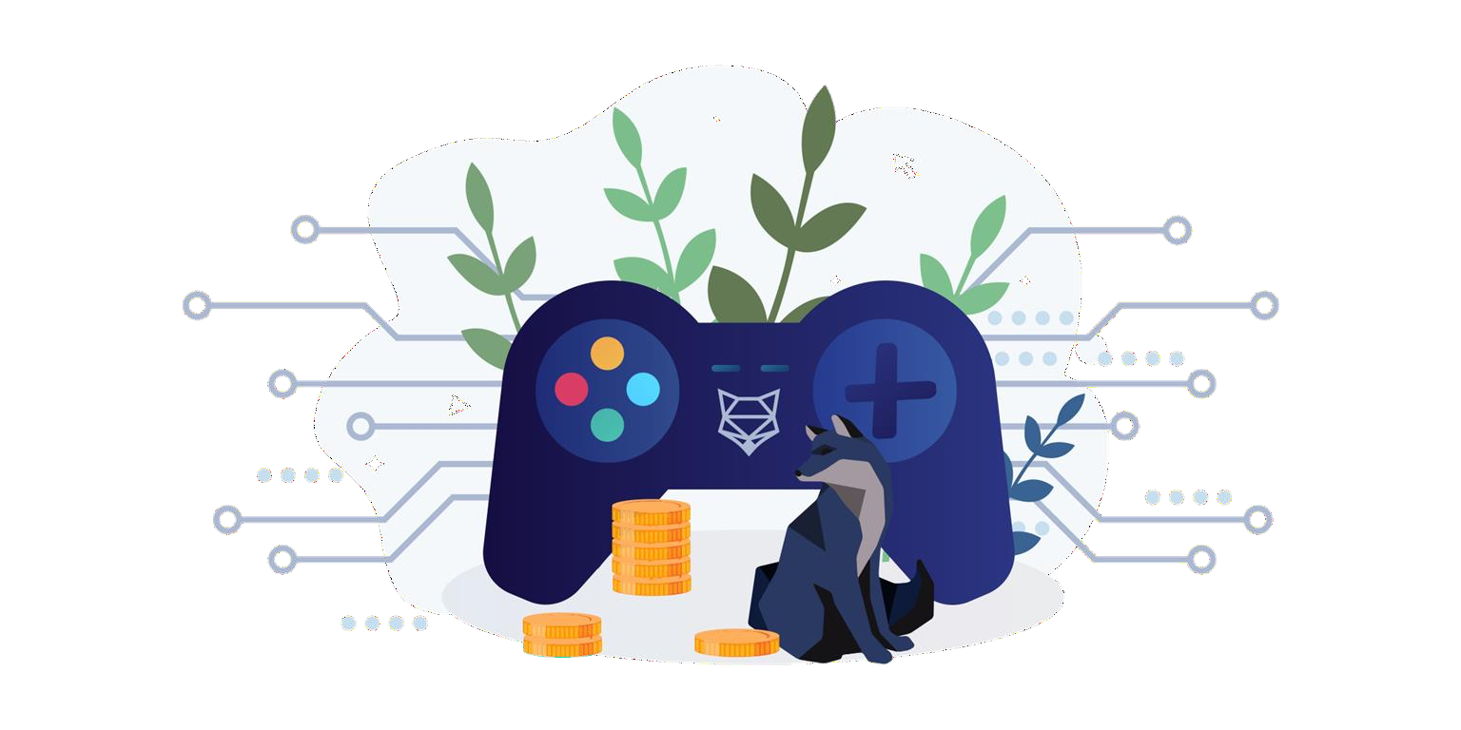
WYZth TOKEN ON GAMING
& E-COMMERCE?
Telegram:-@incomesathi
the Listing of Wyzth token on gaming portable www.luckybee.io &
www.betnext.io
and its effect on the development of d-app community. YLE a e- commerce platform for community and its features to swap Bitcoin , Eth, Tron & Wyzth from Fiat ( INR) Overall Wyzth( Yzh token )use and its role and many many more.

Slide 21


THANKS
www.incomesathi.com
CREDITS: This presentation template was created by Slidesgo,
including icons by Flaticon, and infographics & images by Freepik

